Slide 1

Intelligent Financial Planning Hub
This presentation introduces the Finance Tracker, a web-based application designed to help users manage their personal finances.
By - Team 4

Slide 2

Project Team Members
1. P V Shyam Sundar Lal (Team Lead)
2. Abhinandan S Vishwaroop
3. Nivedita Pal
4. Pulicharla Nikhitha

Slide 3
Overview of our Project
The Finance Tracker is a sleek, web-based tool for managing personal finances with ease. It offers user-friendly features like expense tracking (add, update, delete), budget setting, and real-time financial insights through interactive dashboards. Users can set category-specific budget limits, receive alerts for overspending, and track financial goals effortlessly. With modules for authentication, expense management, reporting, and budget planning, Finance Tracker empowers users to take control of their money with visually appealing dashboards and actionable insights.

Slide 4
Project Overview
Key Functionalities
Technology Stack
User registration and login
Frontend: HTML, CSS, JavaScript
Expense management
Backend: Django (Python)
Financial reporting
Database: MySQL
Budget planning

Slide 5
Milestones Overview
Milestone - 1
Module – 1: User Authentication
Module – 2: Expense Management
Milestone - 2
Module – 3: Financial Reporting
Milestone - 3
Module – 4: Dashboard and Data Visualization
Milestone - 4
Module – 5: Budget Planning and Alerts

Slide 6
Milestone - 1

Slide 7
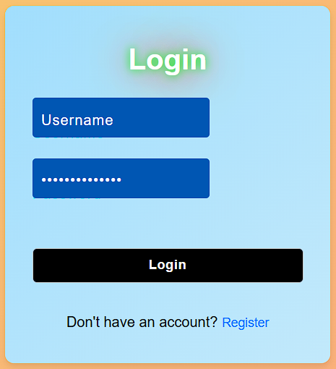
Milestone 1: User Authentication & Expense Management
1
User Registration
2
User Login
Allows new users to create an account with form validation.
Registered users can securely log in with error handling.
3
Dashboard Redirection
Successful login redirects users to their personalized dashboard.

Slide 8
Milestone 1
Module 1: User Authentication &
Expense Management
Home Page
Registration Page
Welcomes users with a friendly message and provides easy access to login and registration options.
Allows new users to create an account with form validation.
Login Page
User Profile
Enables registered users to access their accounts with error handling.
Serves as the user's central hub, featuring a menu with options to navigate to the dashboard, add or view expenses, and access detailed financial reports.

Slide 9
Milestone 1: User Authentication & Expense Management
Screenshots:
Home Page
Registration Page
Login Page
User Profile

Slide 10

Milestone 1: User Authentication & Expense Management
Home Page
Registration Page
Login Page
User Profile

Slide 11
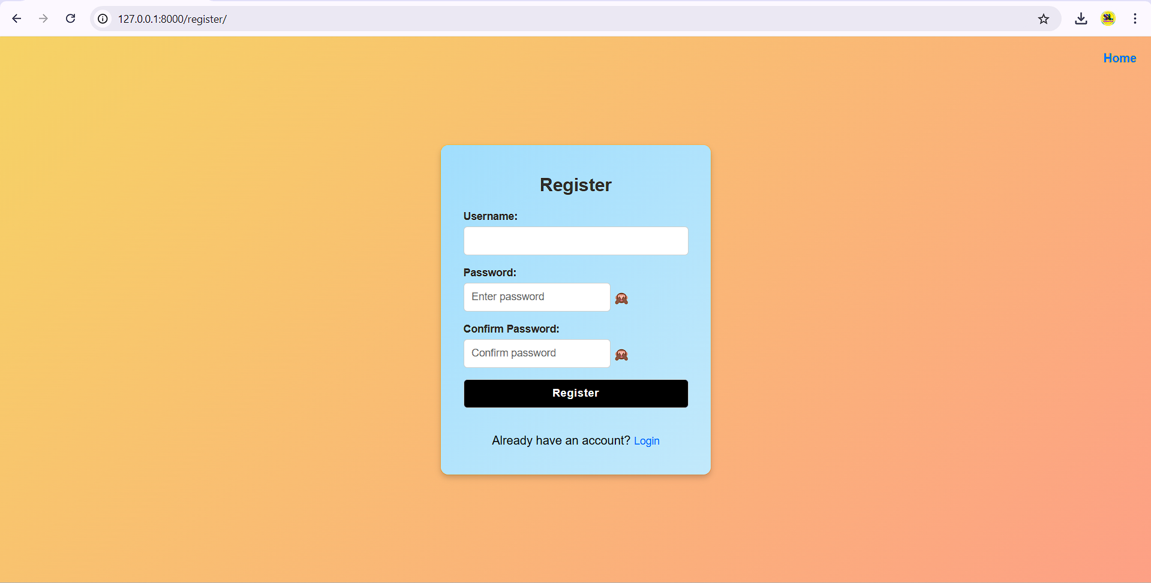
Milestone 1: User Authentication & Expense Management
Home Page
Registration Page
Login Page
User Profile

Slide 12
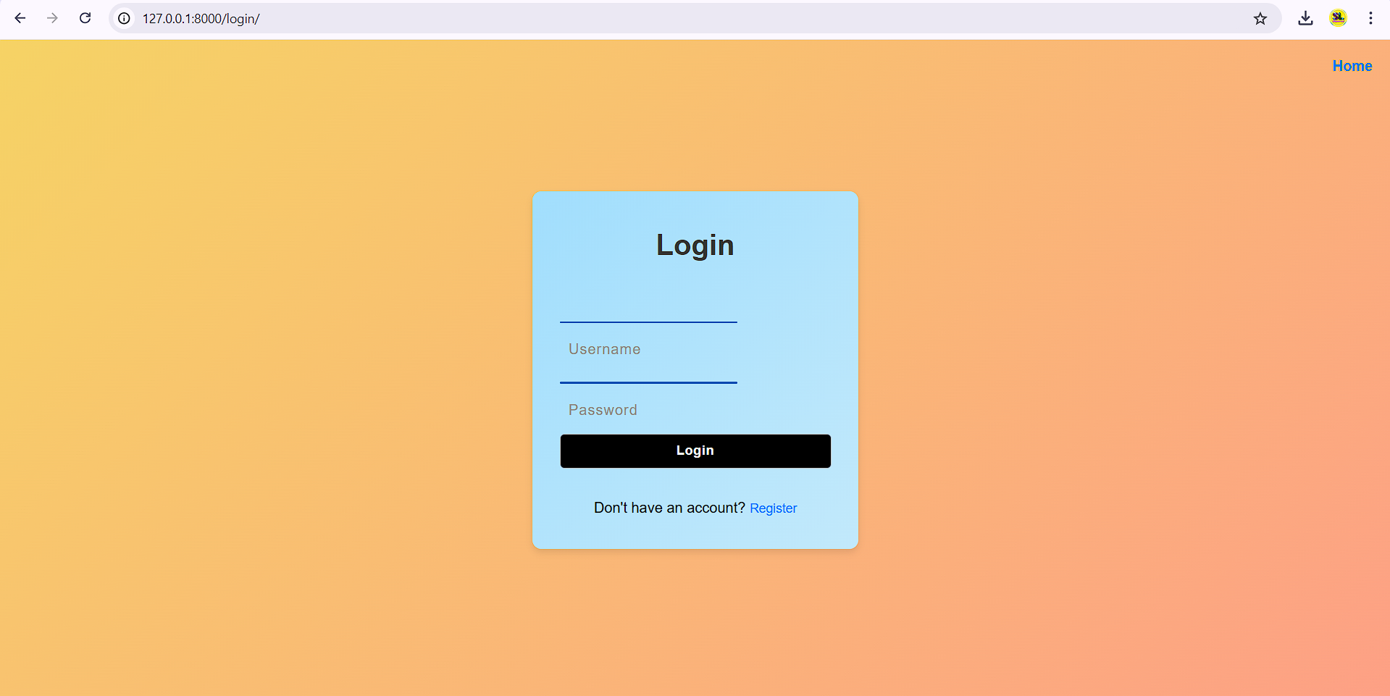
Milestone 1: User Authentication & Expense Management
Home Page
Registration Page
Login Page
User Profile

Slide 13
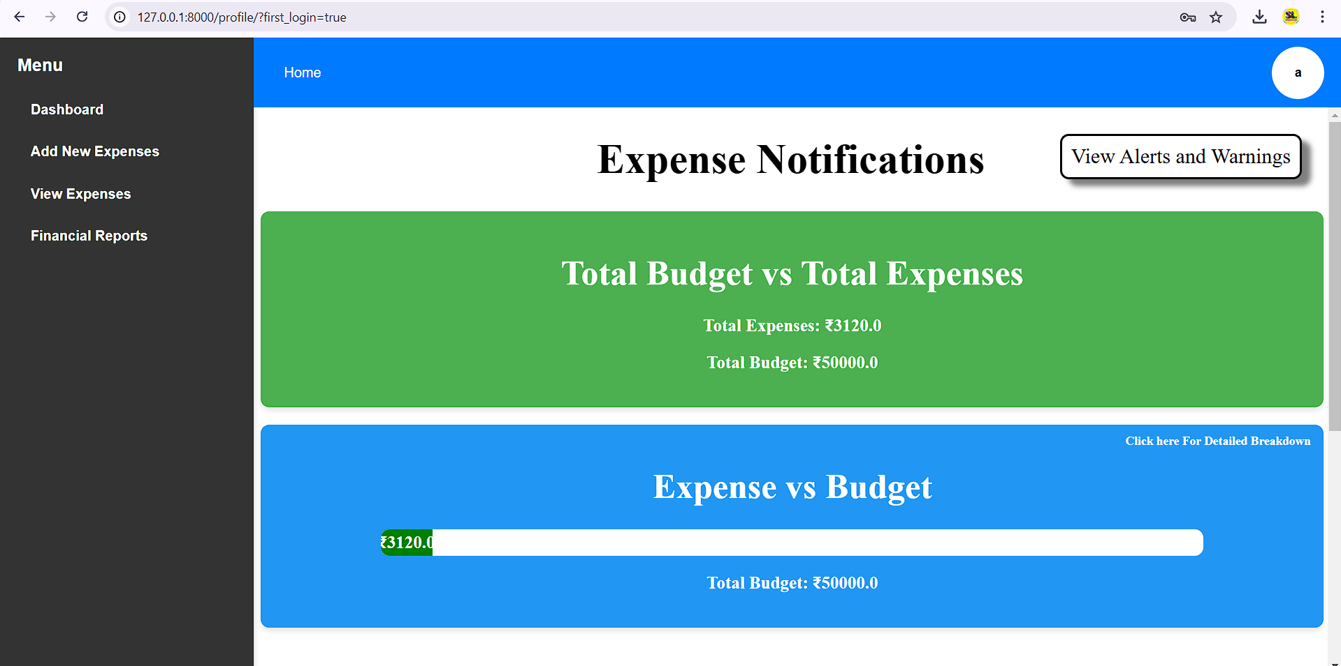
Milestone 1: User Authentication & Expense Management
Home Page
Registration Page
Login Page
User Profile

Slide 14
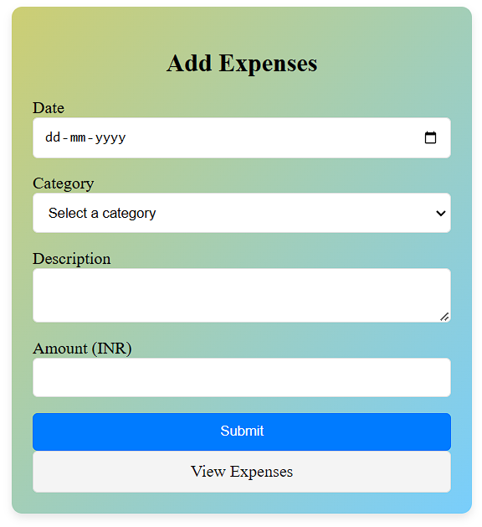
Milestone 1: Expense Management
1
Add Expenses
2
View Expenses
Users can record their expenses by entering details such as amount, category, date, and description.
A comprehensive list of all recorded expenses is displayed, allowing users to track their spending history easily.
3
Edit or Delete Expenses
Users can update existing expense details or remove them entirely, offering flexibility and control over their financial data.

Slide 15
Milestone 1
Module 2: Expense Management
Add Expenses
View Expenses
Users can enter their expenses with details like amount, category, date, and description.
Allows users to see a list of all their recorded expenses, displaying key details like amount, category, and date.
Filter Option View Expenses
Update Expenses
Allows users to filter the expenses recorded in the data bases with respect to date to and from ranges and also able to filter them with respective to the category of the expenses.
Enables users to edit existing expense entries by modifying details like amount, category, or description, or to delete any expense they no longer wish to track.

Slide 16

Milestone 1
Module 2: Expense Management
Add Expenses
View Expenses
Update Expenses

Slide 17
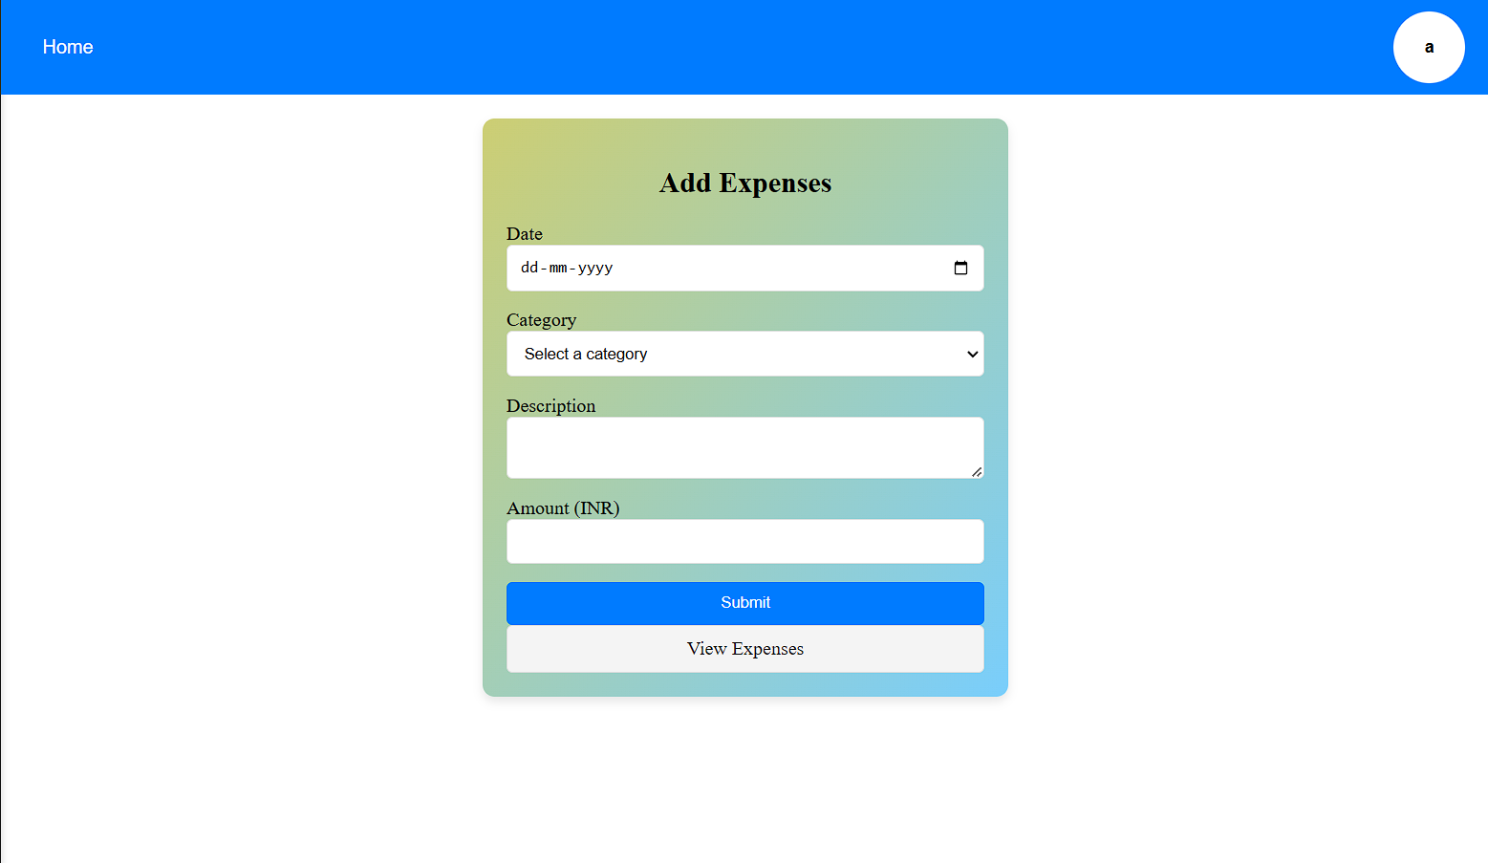
Milestone 1
Module 2: Expense Management
Add Expenses
View Expenses
Update Expenses

Slide 18
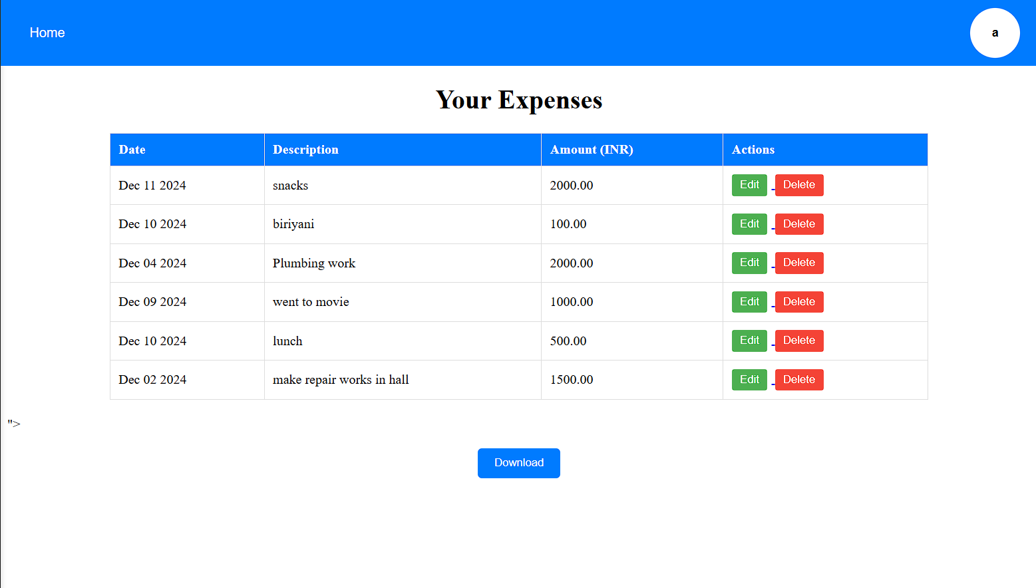
Milestone 1
Module 2: Expense Management
Add Expenses
View Expenses
Update Expenses

Slide 19
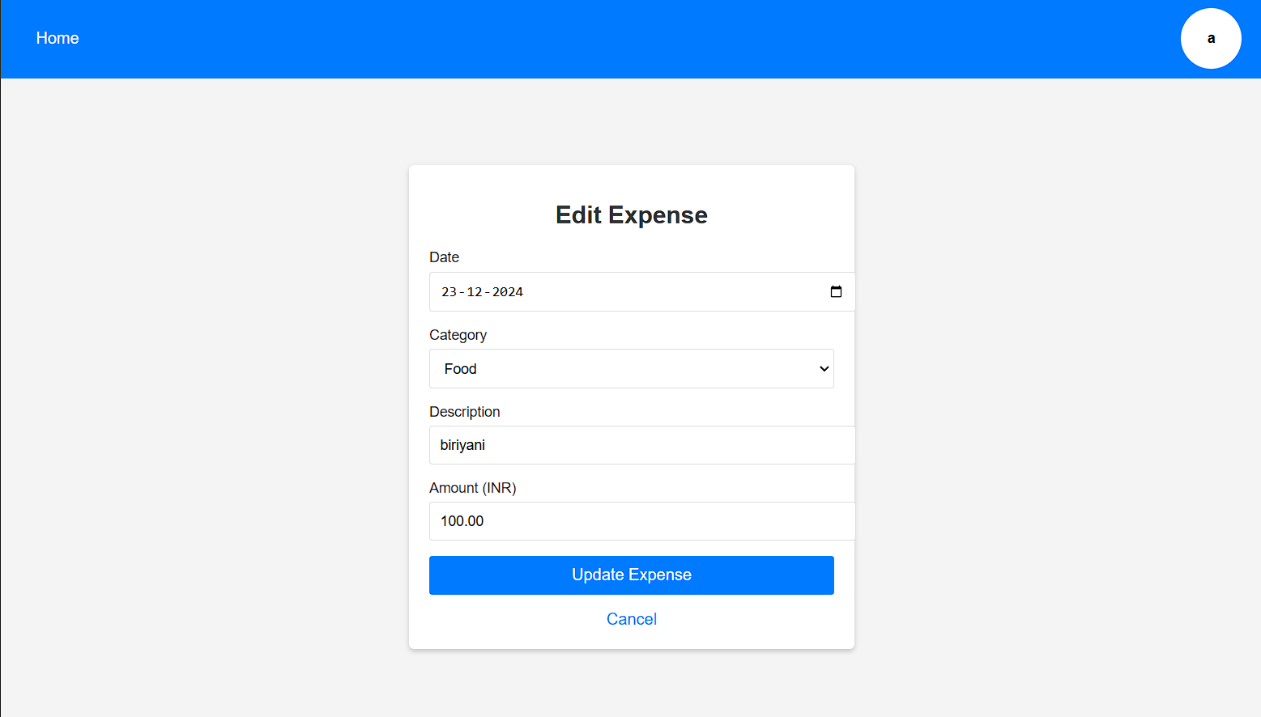
Milestone 1
Module 2: Expense Management
Add Expenses
View Expenses
Update Expenses

Slide 20



Key Takeaways
User-Centric Design
1
Secure Authentication
2
Ensuring user data privacy and security.
Comprehensive Expense Management
3
Providing users with tools to track and manage their finances effectively.

Slide 21
Milestone - 2

Slide 22
Milestone 2
Module 3: Financial Reporting Module
Expense Calculation
The system calculates total and average expenses.
Visualizations
PDF Export
Charts and graphs represent spending patterns, such as pie charts for categories and line charts for monthly expenses.
Users can download reports in PDF format for offline access.

Slide 23

Milestone 2
Module 3: Financial Reporting Module
Expense Calculation
Visualizations
PDF Export

Slide 24
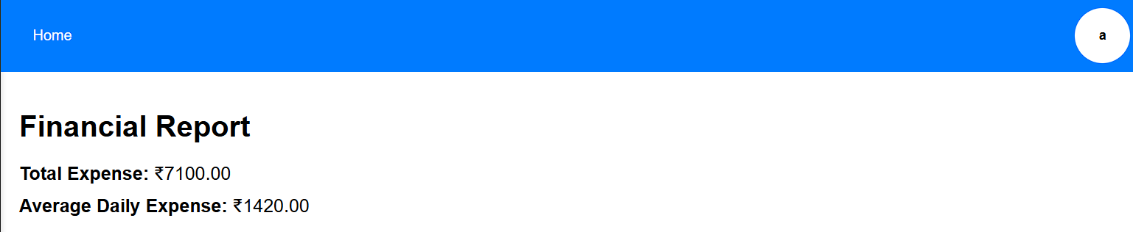
Module 3: Financial Reporting Module
Expense Calculation
Visualizations
PDF Export

Slide 25
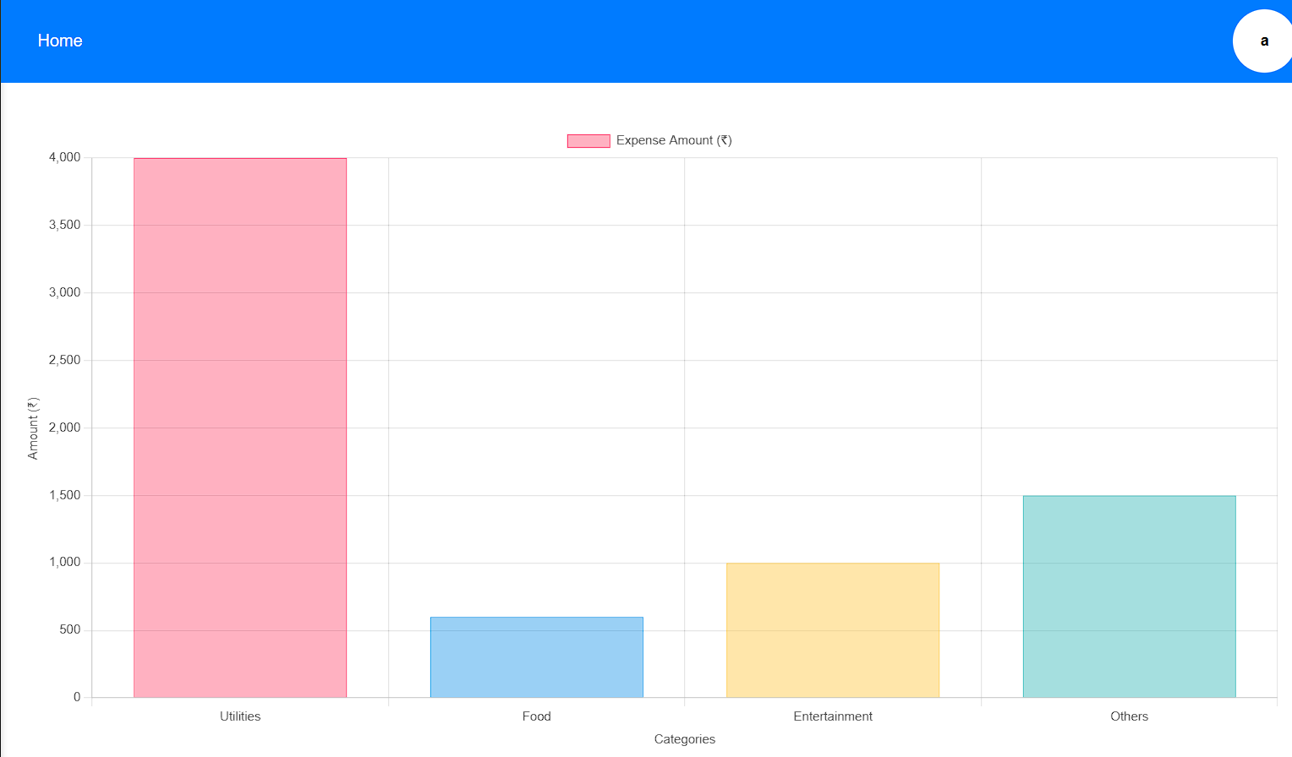
Module 3: Financial Reporting Module
Expense Calculation
Visualizations
PDF Export

Slide 26
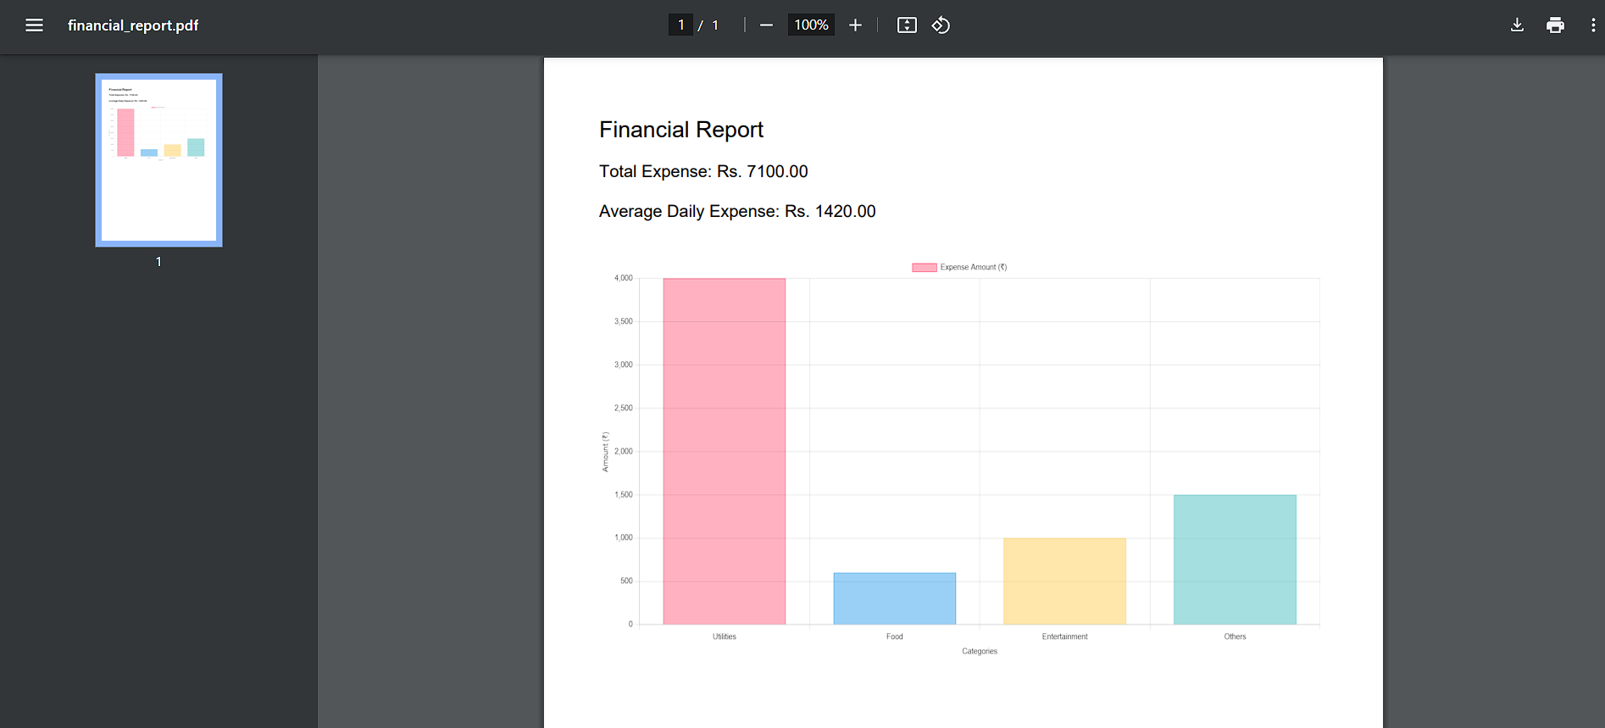
Module 3: Financial Reporting Module
Expense Calculation
Visualizations
PDF Export

Slide 27
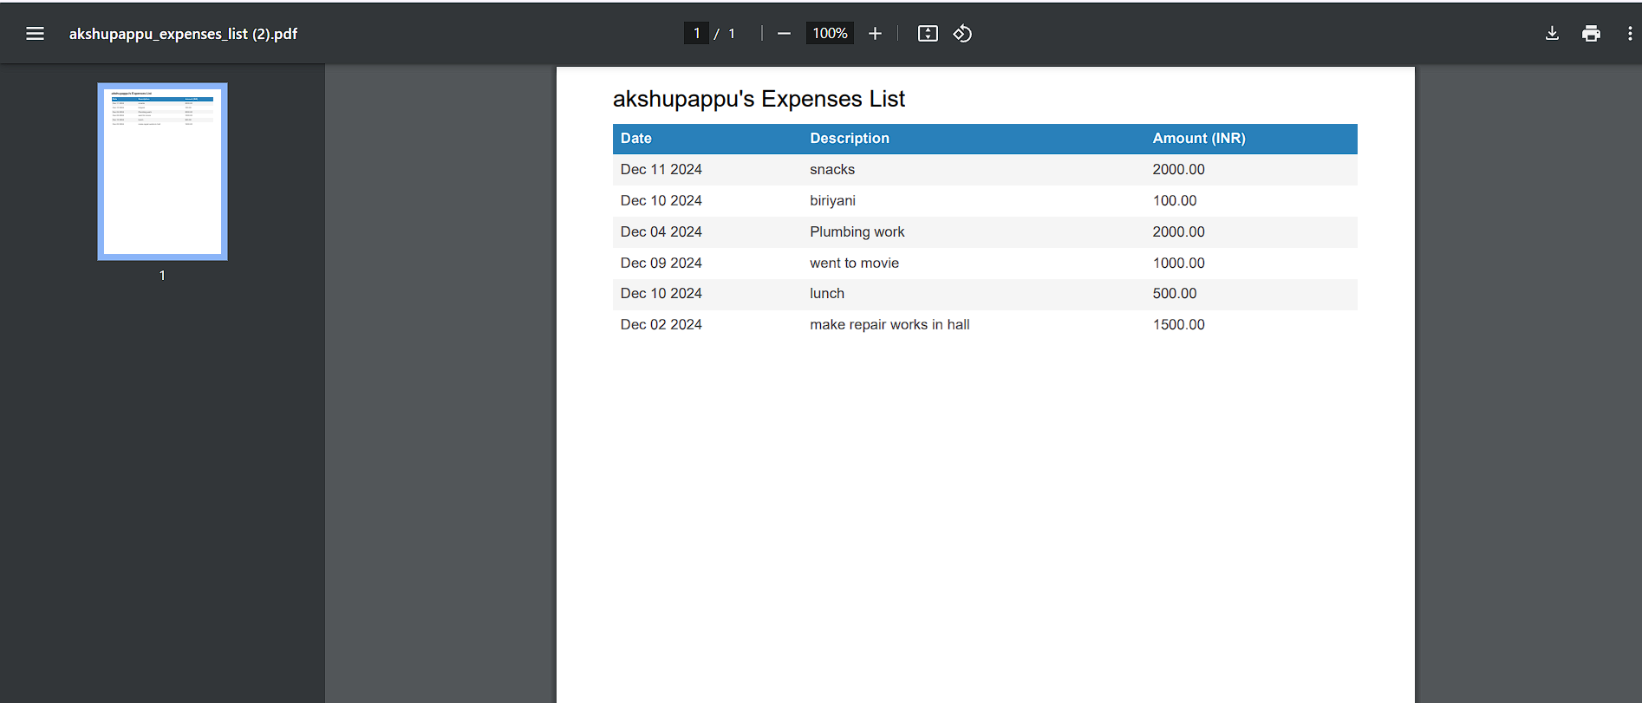
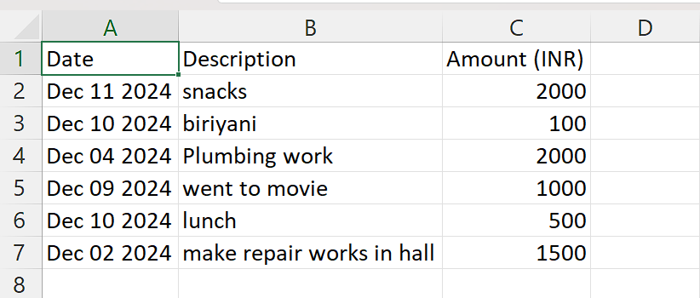
Financial Reports: Expense List
PDF View
Excel View

Slide 28
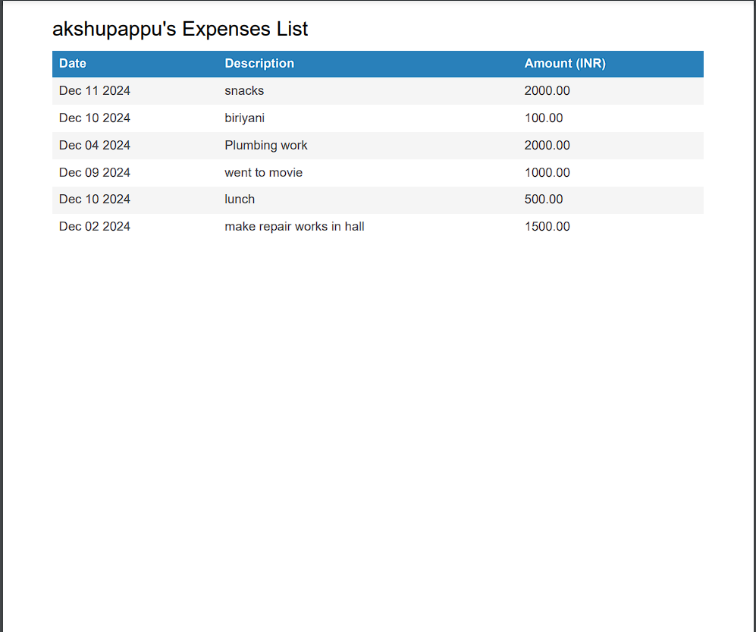
PDF Export: View Expenses
For PDF export of the View Expenses section, JavaScript with the jsPDF library is used to generate the PDF file. The report, containing the user's expense details, is saved with the filename formatted as "expenses_list.pdf", making it personalized and easy to identify.

Slide 29
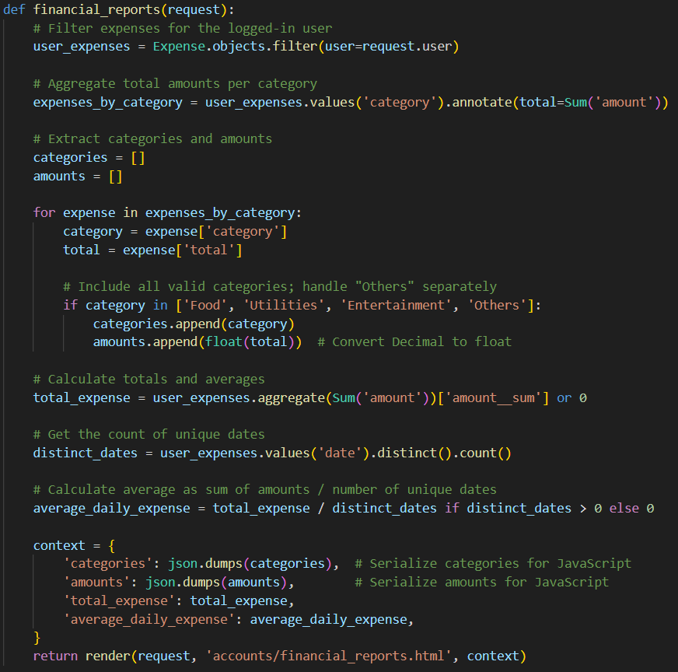
Backend Logic: Expense Calculation
The backend logic for calculating expense totals and averages is implemented using a combination of programming languages and database interactions. This ensures accurate and efficient calculations for generating financial reports.

Slide 30
Milestone - 3

Slide 31

Module 4: Dashboard and Data Visualization
This module focuses on providing users with a centralized view of their financial metrics. It includes interactive charts and graphs to visualize spending trends and filters for viewing expenses based on categories or date ranges. A budget tracking feature with visual alerts helps users monitor overspending. The dashboard dynamically updates in real-time as new expenses are added, ensuring up-to-date financial insights. Additionally, the design is responsive, making it accessible across various devices.

Slide 32
Expense Breakdown Bar Plots
Visualize Spending Patterns
Gain Financial Insights
Users can visualize their spending patterns by categorizing expenses and presenting them as intuitive bar charts.
This helps users gain a clear understanding of how their finances are allocated across different categories.

Slide 33
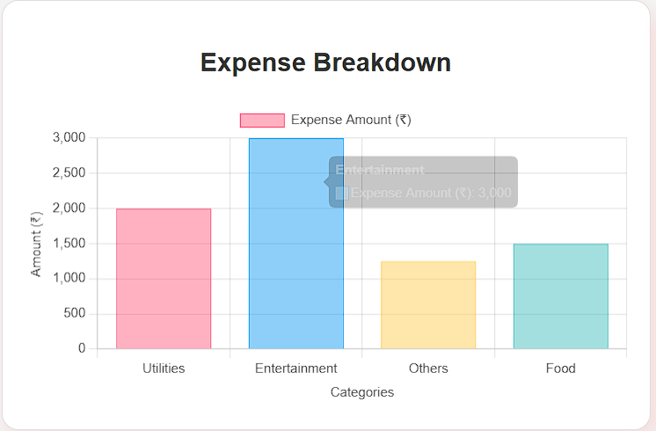
Expense Breakdown Bar Plots
Screen Shots:

Slide 34




Expense Speedometer
Track Spending
Dynamic Needle Color
Approaching Limit
A visual gauge that tracks a user's spending against their set budget limit.
Clear indicators show if the user is within budget, approaching the limit, or has overspent.
Helps users quickly assess their financial health at a glance.

Slide 35
Expense Speedometer
Screen Shots:
Expense under the Budget:
Expense under Warning limit of the Budget
Expense under Alert limit of the Budget

Slide 36
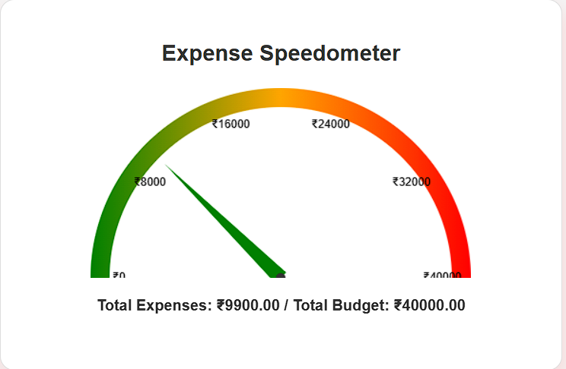
Expense Speedometer
Screen Shots:
Expense under the Budget:
Expense under Warning limit of the Budget
Expense under Alert limit of the Budget

Slide 37
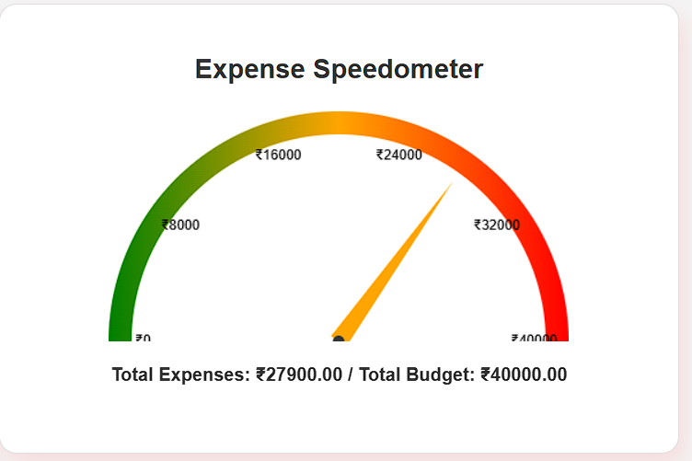
Expense Speedometer
Screen Shots:
Expense under the Budget:
Expense under Warning limit of the Budget
Expense under Alert limit of the Budget

Slide 38
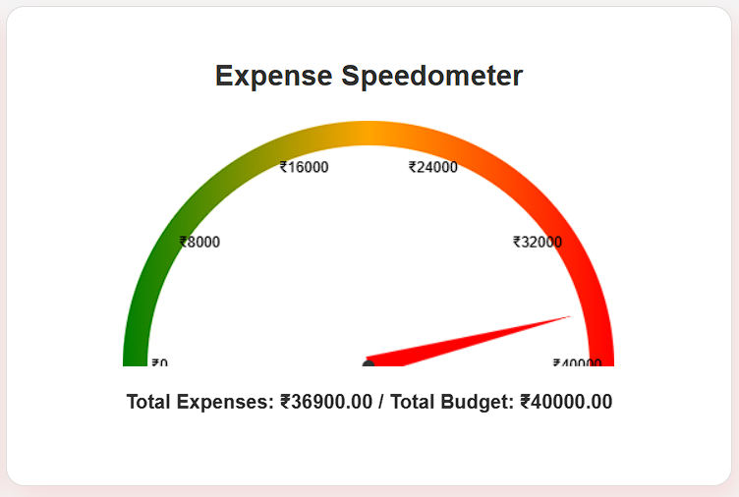
Expense Speedometer
Screen Shots:
Expense under the Budget:
Expense under Warning limit of the Budget
Expense under Alert limit of the Budget

Slide 39
Latest Expenses
Quick Snapshot
Stay Updated
Users can see a quick snapshot of their recent financial activities by displaying the five most recent expenses.
This ensures users stay updated with their spending patterns and can easily review their latest transactions at a glance.

Slide 40
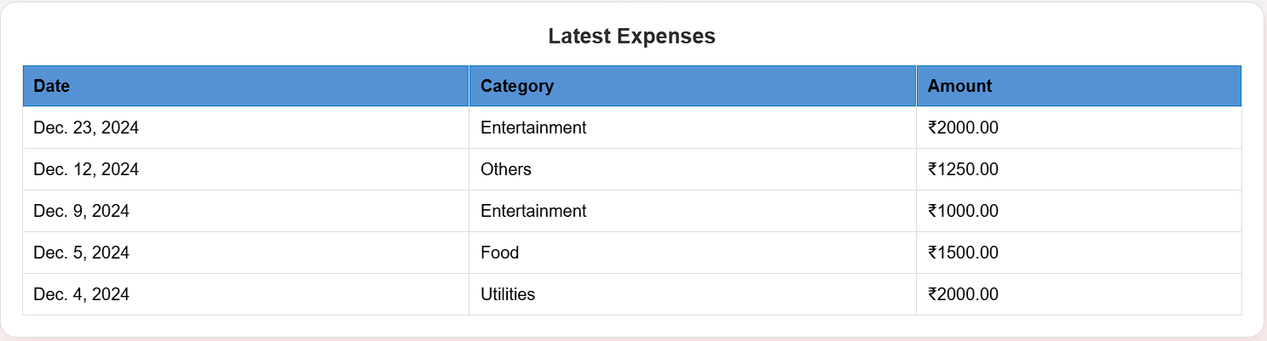
Latest Expenses
Screen Shots:

Slide 41



Real-Time Updates
1
Dynamic Updates
2
Up-to-Date Insights
3
Informed Decisions

Slide 42
Responsive Design
1
Accessible Across Devices
2
Seamless User Experience
3
Improved Usability

Slide 43
Milestone - 4

Slide 44

Module 5: Budget Planning and Alerts
This presentation will explore the Budget Planning and Management Module, a powerful tool designed to empower users to take control of their finances.

Slide 45
Empowering Financial Control
Budget Limit Setting
Alert System
Users can define spending limits for each expense category individually, such as Food, Utilities, Entertainment, and Others. This personalized approach allows users to allocate their finances according to their unique needs and priorities.
The module features real-time alerts to notify users when they approach or exceed their limits, ensuring they stay on track.

Slide 46

Key Features: Budget Limit Setting
The Budget Limit Setting feature allows users to define specific spending limits for each expense category individually, such as Food, Utilities, Entertainment, and Others.

Slide 47
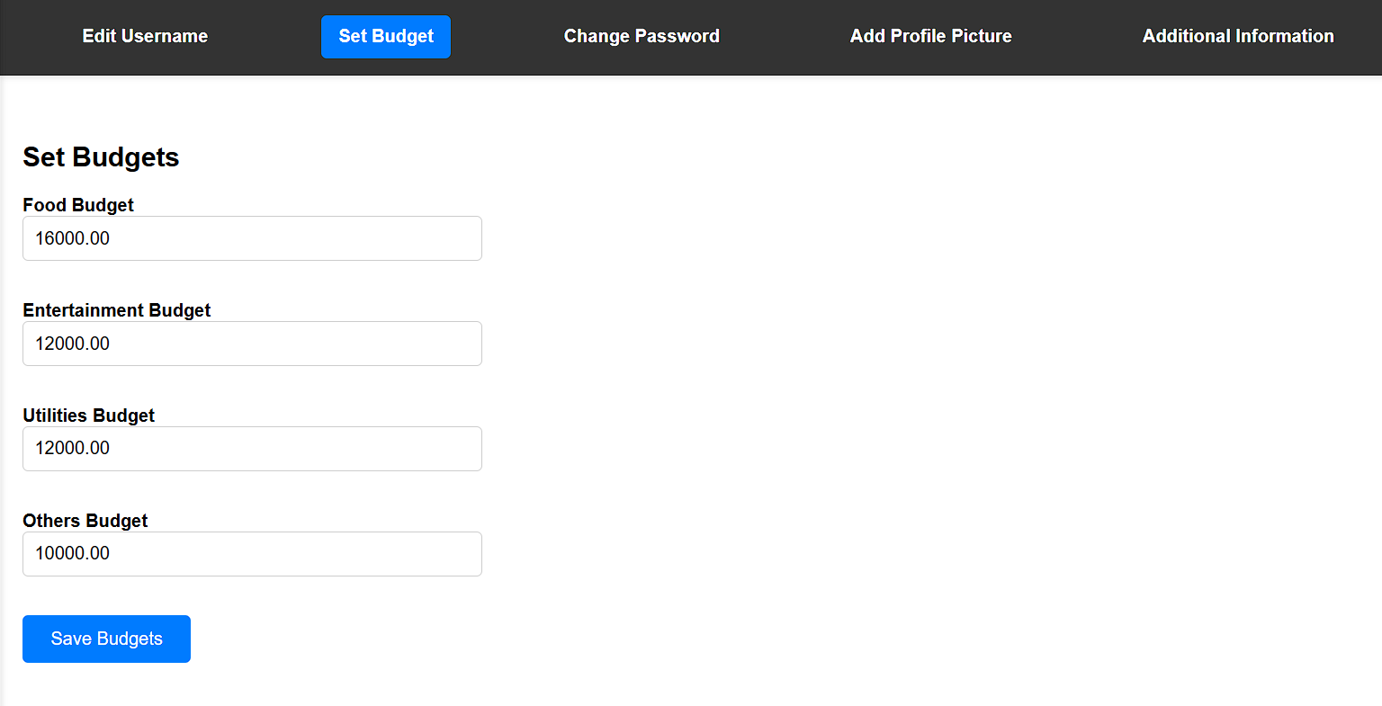
Key Features: Budget Limit Setting
Screen Shots:

Slide 48
Visualizing Financial Progress
1
Budget vs. Actual Spending Comparison
2
Interactive Breakdown
A visual comparison highlights areas of overspending and savings opportunities, offering actionable insights.
Users can drill down into specific categories to gain a deeper understanding of where their funds are being allocated.

Slide 49
Visualizing Financial Progress
Budget vs. Actual Spending Comparison
Expense under the Budget:
Expense under Warning limit of the Budget
Expense under Alert limit of the Budget

Slide 50
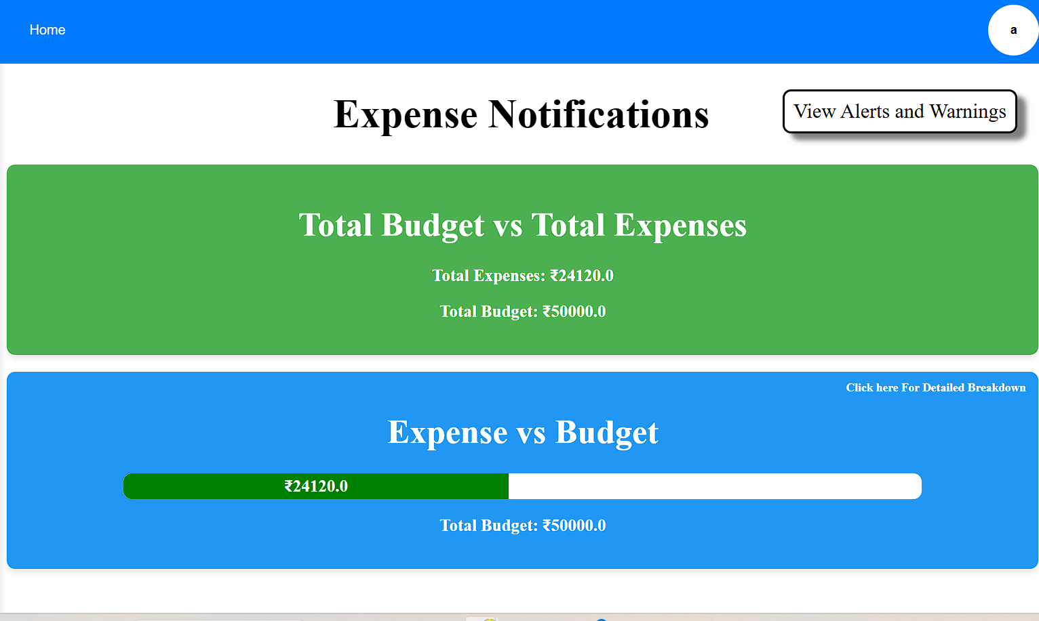
Visualizing Financial Progress
Budget vs. Actual Spending Comparison
Expense under the Budget:
Expense under Warning limit of the Budget
Expense under Alert limit of the Budget

Slide 51
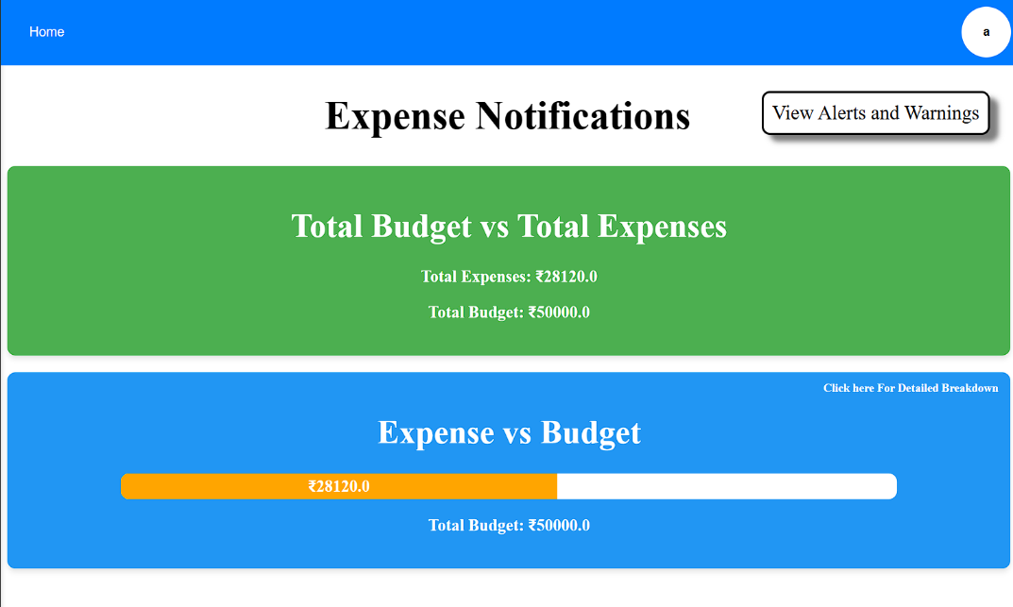
Visualizing Financial Progress
Budget vs. Actual Spending Comparison
Expense under the Budget:
Expense under Warning limit of the Budget
Expense under Alert limit of the Budget

Slide 52
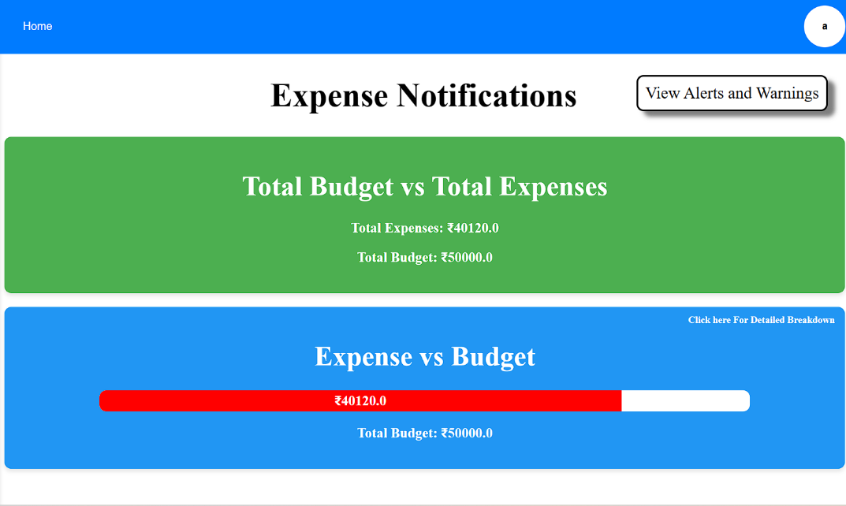
Visualizing Financial Progress
Budget vs. Actual Spending Comparison
Expense under the Budget:
Expense under Warning limit of the Budget
Expense under Alert limit of the Budget

Slide 53
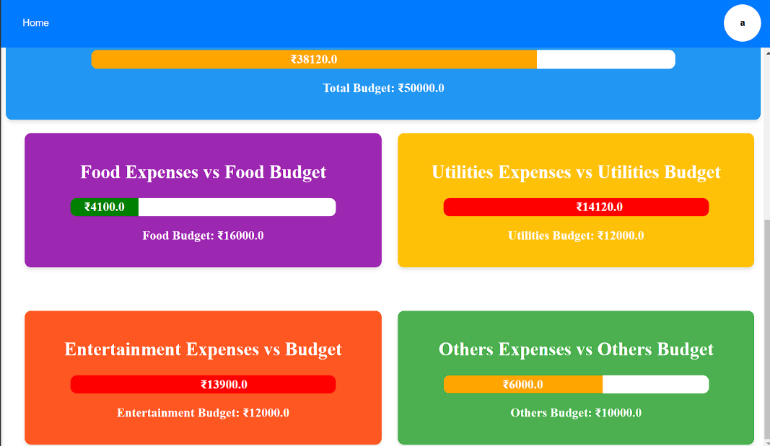
Visualizing Financial Progress
Interactive Breakdown

Slide 54
Staying on Track with Alerts
The Alert System keeps users informed about their spending by notifying them when they are approaching or exceeding their budget limits. As users track their expenses across different categories, the system triggers automatic alerts when their spending reaches a predefined threshold.

Slide 55
Key Features: Alert System
The Alert System is a critical feature in financial management tools that helps users stay on track with their budgets by providing timely notifications when they approach or exceed their spending limits. This system continuously monitors expenses against user-defined budgets, sending real-time alerts when thresholds, such as 75%, 90%, or 100%, are reached. Users can customize these alerts based on categories (e.g., groceries, entertainment), frequency, and delivery mode (email, SMS, or app notifications). By keeping users informed about their financial status, the Alert System encourages proactive spending adjustments, promotes goal-oriented budgeting, and helps reduce financial stress by preventing overspending.

Slide 56
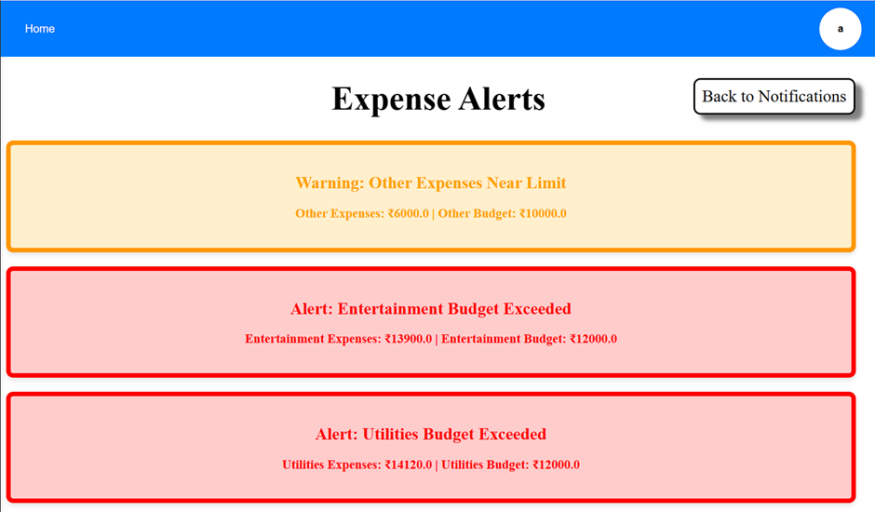
Key Features: Alert System
All Alerts and Warnings for specific Categories

Slide 57
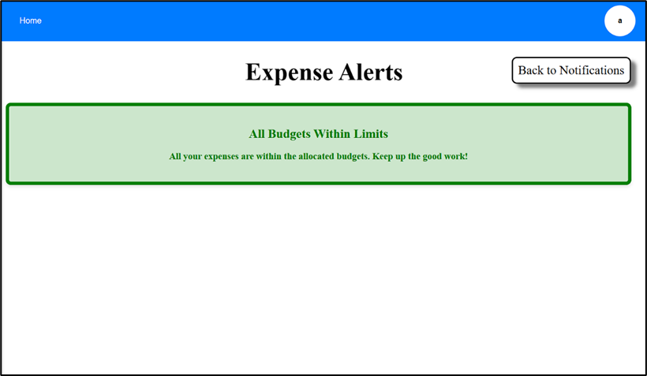
Key Features: Alert System
When All Budgets are Within the LIMITS of Expenses

Slide 58
Conclusion
The Budget Planning and Management Module empowers users to take control of their finances by providing tools to set, monitor, and achieve financial goals. This module simplifies budget management, fosters smart spending habits, and supports users in building a secure financial future.

Slide 59
Future Scope
Integrate machine learning to provide personalized financial advice and spending pattern analysis.
Develop a mobile companion app for seamless tracking on the go.
Add some collaborative features which allow shared accounts for families or teams to track joint expenses.
Connect with banks, payment systems, and digital wallets (third-party) for real-time updates.
Introduce automated reminders for due bills and subscriptions.
Provide detailed financial insights with customizable reports and forecasts.

Slide 60
☺ THANK YOU ☺

